Slide 1

COMPUTER NETWORKS Module 3 Basics of Network, Transport and Application Layers
School of Computer Science & IT Department of BCA

Slide 2
Network Layer

Slide 3
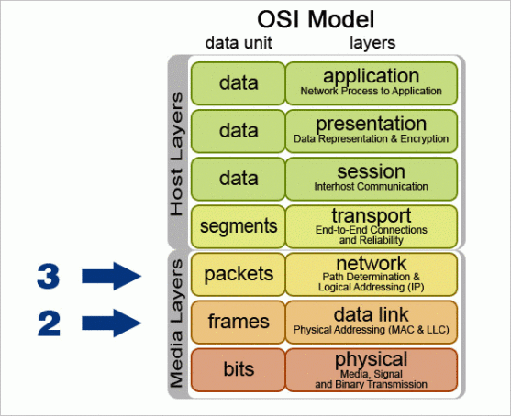
Network Layer:
The network layer in the TCP/IP protocol suite is responsible for the host-to-host delivery of datagrams.
It provides services to the transport layer and receives services from the data-link layer.

Slide 4
Network Layer (Cont..)
The main protocol in network layer is Internet Protocol version 4 (IPv4), is responsible for packetizing, forwarding, and delivery of a packet at the network layer.
The Internet Control Message Protocol version 4 (ICMPv4) helps IPv4 to handle some errors that may occur in the network-layer delivery.
The Internet Group Management Protocol (IGMP) is used to help IPv4 in multicasting.
The Address Resolution Protocol (ARP) is used to glue the network and data-link layers in mapping network-layer addresses to link-layer addresses.

Slide 5
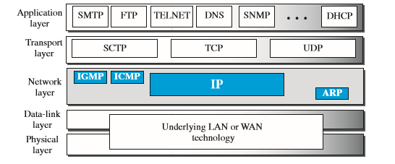
Figure shows the positions of these four protocols in the TCP/IP protocol suite.

Slide 6
Internet Protocol (IP )
The Internet Protocol (IP) is the principal communications protocol in the Internet protocol suite for relaying datagrams across network boundaries.
Its routing function enables internetworking, and essentially establishes the Internet.
IP has the task of delivering packets from the source host to the destination host solely based on the IP addresses in the packet headers. For this purpose, IP defines packet structures that encapsulate the data to be delivered. It also defines addressing methods that are used to label the datagram with source and destination information.
The first major version of IP, Internet Protocol Version 4 (IPv4), is the dominant protocol of the Internet. Its successor is Internet Protocol Version 6 (IPv6), which has been in increasing deployment on the public Internet since c. 2006.

Slide 7
IP standards
Transmission Control Protocol(TCP) and Internet Protocol(IP) are two of the best known members of the Internet protocol suite, a suite of network communication protocols developed by Stanford University to facilitate heterogeneous connectivity.
The Internet protocol suite provides the protocols that enable all of the networks of the Internet to communicate. Every computer on the Internet supports TCP/IP.
The protocols in the TCP/IP suite are layered protocols. Layered protocol suites separate duties between individual protocols in the group. IP is the heart of the Internet protocol suite.
IP addresses are globally unique, 32-bit numbers assigned by the Network Information Center. Globally unique addresses permit IP networks anywhere in the world to communicate with each other. Internet routers use these IP addresses to deliver IP packets to their destination.
TCP is a connection-oriented transport protocol that sends data as an unstructured stream of bytes. TCP provides two services that IP is missing: guaranteed delivery and serialization of data.

Slide 8
IP versions
IPV4
IPv4 (Internet Protocol Version 4) is the fourth revision of the Internet Protocol (IP) used to to identify devices on a network through an addressing system. The Internet Protocol is designed for use in interconnected systems of packet-switched computer communication networks
IPV6
IPv6 is the successor to Internet Protocol Version 4 (IPv4). It was designed as an evolutionary upgrade to the Internet Protocol and will, in fact, coexist with the older IPv4 for some time. IPv6 is designed to allow the Internet to grow steadily, both in terms of the number of hosts connected and the total amount of data traffic transmitted.

Slide 9
Functions
Addressing
Data encapsulation and formatting packaging
Fragmentation and reassembly
Routing and internet delivery

Slide 10
IPv4
IPv4 is an unreliable datagram protocol—a best-effort delivery service. The term best-effort means that IPv4 packets can be corrupted, be lost, arrive out of order, or be delayed, and may create congestion for the network.
If reliability is important, IPv4 must be paired with a reliable transport-layer protocol such as TCP.
An example of a more commonly understood best-effort delivery service is the post office. The post office does its best to deliver the regular mail but does not always succeed. If an unregistered letter is lost or damaged, it is up to the sender or would-be recipient to discover this. The post office itself does not keep track of every letter and cannot notify a sender of loss or damage of one.
IPv4 is also a connectionless protocol that uses the datagram approach. This means that each datagram is handled independently, and each datagram can follow a different route to the destination. This implies that datagrams sent by the same source to the same destination could arrive out of order. Again, IPv4 relies on a higher-level protocol to take care of all these problems.

Slide 11
IPv4 addressing
The identifier used in the IP layer of the TCP/IP protocol suite to identify the connection of each device to the Internet is called the Internet address or IP address.
An IPv4 address is a 32-bit address that uniquely and universally defines the connection of a host or a router to the Internet.
The IP address is the address of the connection, not the host or the router, because if the device is moved to another network, the IP address may be changed.
IPv4 addresses are unique in the sense that each address defines one, and only one, connection to the Internet.
If a device has two connections to the Internet, via two networks, it has two IPv4 addresses. IPv4 addresses are universal in the sense that the addressing system must be accepted by any host that wants to be connected to the Internet.

Slide 12
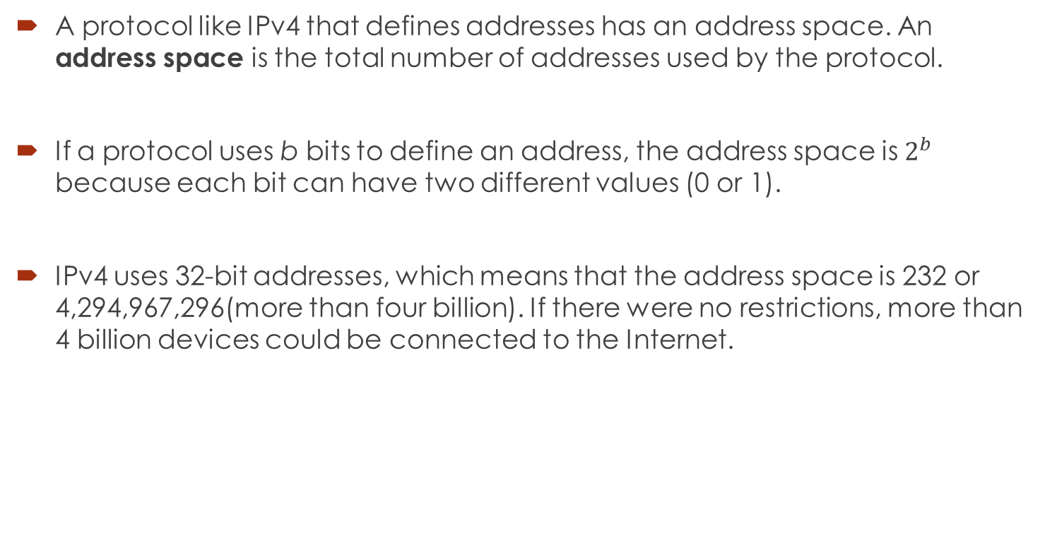
Address Space
A protocol like IPv4 that defines addresses has an address space. An address space is the total number of addresses used by the protocol.
If a protocol uses b bits to define an address, the address space is $2^{b}$ because each bit can have two different values (0 or 1).
IPv4 uses 32-bit addresses, which means that the address space is 232 or 4,294,967,296(more than four billion). If there were no restrictions, more than 4 billion devices could be connected to the Internet.

Slide 13
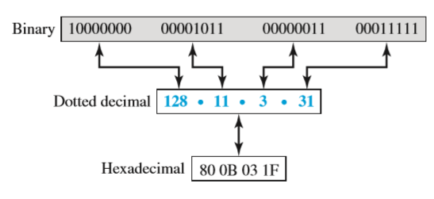
Address Notation
There are three common notations to show an IPv4 address: binary notation (base 2),dotted-decimal notation (base 256), and hexadecimal notation (base 16). In binary notation, an IPv4 address is displayed as 32 bits. To make the address more readable, oneor more spaces are usually inserted between each octet (8 bits).

Slide 14
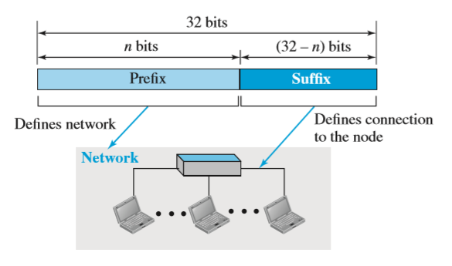
Hierarchy in Addressing:
In any communication network that involves delivery, such as a telephone network or a postal network, the addressing system is hierarchical.
In a postal network, the postal address (mailing address) includes the country, state, city, street, house number, and the name of the mail recipient. Similarly, a telephone number is divided into the country code, area code, local exchange, and the connection.
A 32-bit IPv4 address is also hierarchical, but divided only into two parts. The first part of the address, called the prefix, defines the network; the second part of the address, called the suffix, defines the node (connection of a device to the Internet). The prefix length is n bits and the suffix length is (32 − n) bits.

Slide 15
IPv4 address types
A prefix can be fixed length or variable length.
The network identifier in the IPv4 was first designed as a fixed-length prefix. This scheme, which is now obsolete, is referred to as classful addressing.
The new scheme, which is referred to as classless addressing, uses a variable-length network prefix.

Slide 16
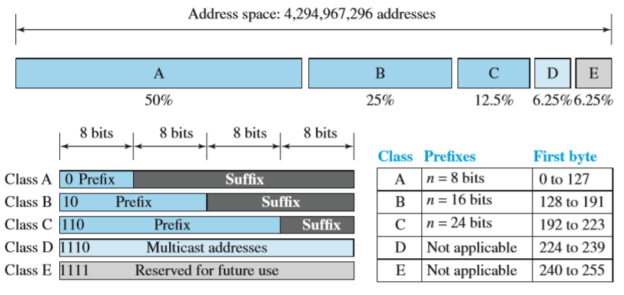
IPv4 address Classes
Classful Addressing
IPv4 address was designed with a fixed-length prefix firstly, but to accommodate both small and large networks, three fixed-length prefixes were designed instead of one (n = 8, n = 16, and n = 24). The whole address space was divided into five classes (class A, B, C, D, and E)

Slide 17
In class A, the network length is 8 bits, but since the first bit, which is 0, defines the class, we can have only seven bits as the network identifier. This means there are only 27 = 128 networks in the world that can have a class A address.
In class B, the network length is 16 bits, but since the first two bits, which are (10)2, define the class, we can have only 14 bits as the network identifier. This means there are only 214 = 16,384 networks in the world that can have a class B address.
All addresses that start with (110)2 belong to class C. In class C, the network length is 24 bits, but since three bits define the class, we can have only 21 bits as the network identifier. This means there are 221 = 2,097,152 networks in the world that can have a class C address.
Class D is not divided into prefix and suffix. It is used for multicast addresses. All addresses that start with 1111 in binary belong to class E. As in Class D, Class E is not divided into prefix and suffix and is used as reserve.

Slide 18
Disadvantages of Classful Addressing
Address Depletion: The reason that classful addressing has become obsolete is address depletion. Since the addresses were not distributed properly, the Internet was faced with the problem of the addresses being rapidly used up, resulting in no more addresses available for organizations and individuals that needed to be connected to the Internet.
Subnetting and Supernetting: To alleviate address depletion, two strategies were proposed and, to some extent, implemented: subnetting and supernetting. In subnetting, a class A or class B block is divided into several subnets. Each subnet has a larger prefix length than the original network.
Advantage of Classful Addressing:
Although classful addressing had several problems and became obsolete, it had one advantage: Given an address, we can easily find the class of the address and, since the prefix length for each class is fixed, we can find the prefix length immediately. In other words, the prefix length in classful addressing is inherent in the address; no extra information is needed to extract the prefix and the suffix.

Slide 19
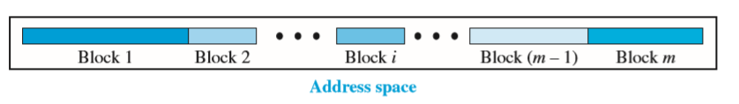
Classless addressing
In classless addressing, the whole address space is divided into variable length blocks. The prefix in an address defines the block (network); the suffix defines the node (device). Theoretically, we can have a block of 20, 21, 22, ...,232 addresses. One of the restrictions, as we discuss later, is that the number of addresses in a block needs to be a power of 2. An organization can be granted one block of addresses. Figure 18.19 shows the division of the whole address space into non-overlapping blocks.
Unlike classful addressing, the prefix length in classless addressing is variable. We can have a prefix length that ranges from 0 to 32.

Slide 20
Classless addressing (Cont…)
The size of the network is inversely proportional to the length of the prefix.
A small prefix means a larger network; a large prefix means a smaller network. We need to emphasize that the idea of classless addressing can be easily applied to classful addressing.
An address in class A can be thought of as a classless address in which the prefix length is 8. An address in class B can be thought of as a classless address in which the prefix is 16, and so on. In other words, classful addressing is a special case of classless addressing.

Slide 21
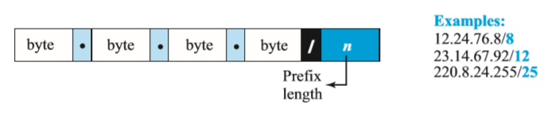
Prefix Length:
Slash Notation The first question that we need to answer in classless addressing is how to find the prefix length if an address is given.
Since the prefix length is not inherent in the address, we need to separately give the length of the prefix. In this case, the prefix length, n, is added to the address, separated by a slash.
The notation is informally referred to as slash notation and formally as classless inter-domain routing or CIDR (pronounced cider) strategy.

Slide 22
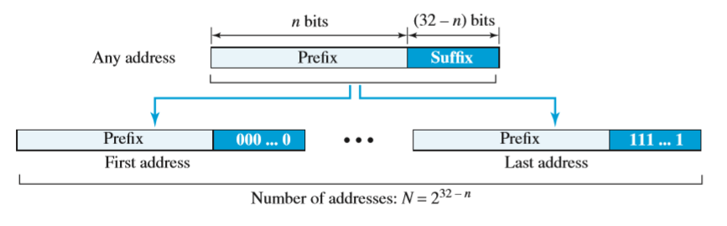
Extracting Information from an Address: Given any address in the block, we normally like to know three pieces of information about the block to which the address belongs: the number of addresses, the first address in the block, and the last address. Since the value of prefix length, n, is given, we can easily find these three pieces of information, as shown in Figure 18.21.
1. The number of addresses in the block is found as N = 232−n.
2. To find the first address, we keep the n leftmost bits and set the (32 − n) rightmost bits all to 0s.
3. To find the last address, we keep the n leftmost bits and set the (32 − n) rightmost bits all to 1s.

Slide 23
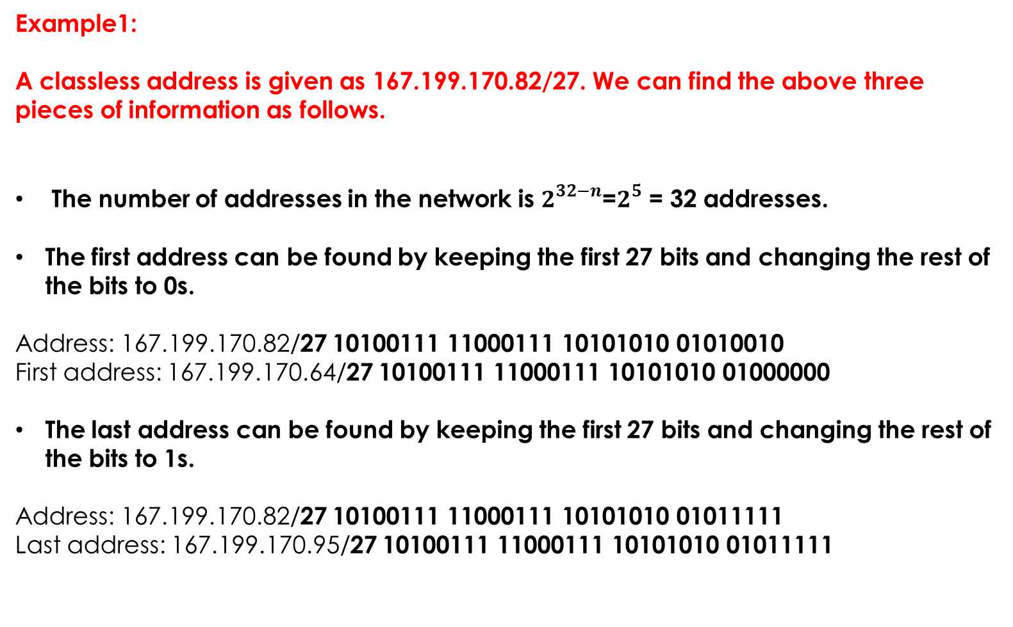
Example1:
A classless address is given as 167.199.170.82/27. We can find the above three pieces of information as follows.
The number of addresses in the network is $2^{32−n}$=$2^{5}$ = 32 addresses.
The first address can be found by keeping the first 27 bits and changing the rest of the bits to 0s.
Address: 167.199.170.82/27 10100111 11000111 10101010 01010010
First address: 167.199.170.64/27 10100111 11000111 10101010 01000000
The last address can be found by keeping the first 27 bits and changing the rest of the bits to 1s.
Address: 167.199.170.82/27 10100111 11000111 10101010 01011111
Last address: 167.199.170.95/27 10100111 11000111 10101010 01011111

Slide 24
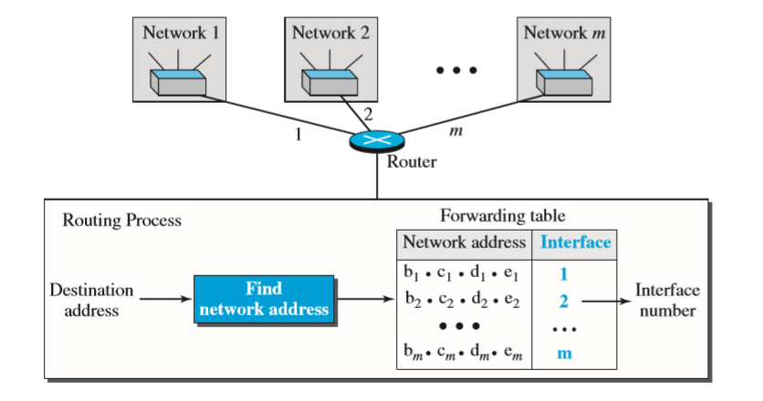
Network Address:
The first address, the network address, is particularly important because it is used in routing a packet to its destination network. For the moment, let us assume that an internet is made of m networks and a router with m interfaces. The network address is actually the identifier of the network; each network is identified by its network address.

Slide 25
Subnet Mask
The subnet mask is used by the TCP/IP protocol to determine whether a host is on the local subnet or on a remote network.
More levels of hierarchy can be created using subnetting.
An organization (or an ISP) that is granted a range of addresses may divide the range into several subranges and assign each subrange to a subnetwork (or subnet).
Note that nothing stops the organization from creating more levels. A subnetwork can be divided into several sub-subnetworks. A sub-subnetwork can be divided into several sub-sub-subnetworks, and so on.

Slide 26
Designing Subnets:
The subnetworks in a network should be carefully designed to enable the routing of packets. We assume the total number of addresses granted to the organization is N, the prefix length is n, the assigned number of addresses to each subnetwork is N_{sub}, and the prefix length for each subnetwork is n_{sub}. Then the following steps need to be carefully followed to guarantee the proper operation of the subnetworks.
The number of addresses in each subnetwork should be a power of 2.
The prefix length for each subnetwork should be found using the following formula:
n_{sub} = 32 − log2N_{sub}
The starting address in each subnetwork should be divisible by the number of addresses in that subnetwork. This can be achieved if we first assign addresses to larger subnetworks.

Slide 27
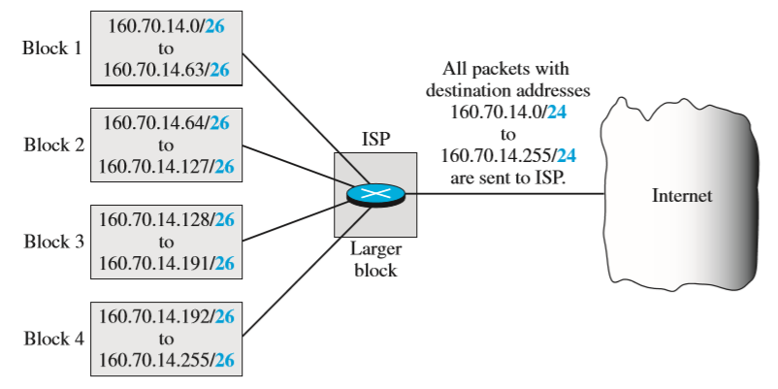
Finding Information about Each Subnetwork:
After designing the subnetworks, the information about each subnetwork, such as first and last address, can be found using the process we described to find the information about each network in the Internet.
Address Aggregation: One of the advantages of the CIDR strategy is address aggregation (sometimes called address summarization or route summarization). When blocks of addresses are combined to create a larger block, routing can be done based on the prefix of the larger block. ICANN assigns a large block of addresses to an ISP.

Slide 28
Default Gateway
A default gateway is the node in a computer network using the interne protocol suite that serves as the forwarding host (router) to other networks when no other route specification matches the destination IP address of a packet.
A gateway is a network node that serves as an access point to another network, often involving not only a change of addressing, but also a different networking technology.
More narrowly defined, a router merely forwards packets between networks with different network prefixes.

Slide 29
Public & Private IP Address
Private IP address of a system is the IP address which is used to communicate within the same network. Using private IP data or information can be sent or received within the same network.
Public IP address of a system is the IP address which is used to communicate outside the network. Public IP address is basically assigned by the ISP (Internet Service Provider).

Slide 30
Difference between Private and Public IP address:
PRIVATE IP ADDRESS | PUBLIC IP ADDRESS
Scope is local. | Scope is global.
It is used to communicate within the network. | It is used to communicate outside the network.
Private IP addresses of the systems connected in a network differ in a uniform manner. | Public IP may differ in uniform or non-uniform manner.
It works only in LAN. | It is used to get internet service.
It is used to load network operating system. | It is controlled by ISP.
It is available in free of cost. | It is not free of cost.
Private IP can be known by entering “ipconfig” on command prompt. | Public IP can be known by searching “what is my ip” on google.

Slide 31
Methods of assigning IP address
Address assignment includes assigning an IP address, a default gateway, one or more domain name servers that resolve names to IP addresses, time servers, and so forth. Before selecting the desired IP address assignment method, the following questions should be answered:
How many devices need an IP address?
Which devices require static IP address assignment?
Is IP address renumbering expected in the future?
Is the administrator required to track devices and their IP addresses?
Do additional parameters (default gateway, name server, and so forth) have to be configured?
Are there any availability issues?
Are there any security issues?

Slide 32
Methods of assigning IP address
the two basic IP address assignment strategies
Static: An IP address is statically assigned to a system. The network administrator configures the IP address, default gateway, and name servers manually by entering them into a special file or files on the end system with either a graphical or text interface.
Dynamic: IP addresses are dynamically assigned to the end systems. Dynamic address assignment relieves the administrator of manually assigning an address to every network device.

Slide 33
IPv6 address
The main reason for migration from IPv4 to IPv6 is the small size of the address space in IPv4.
An IPv6 address is 128 bits or 16 bytes (octets) long, four times the address length in IPv4.
Representation
A computer normally stores the address in binary, but it is clear that 128 bits cannot easily be handled by humans. Several notations have been proposed to represent IPv6 addresses when they are handled by humans. The following shows two of these notations: binary and colon hexadecimal.

Slide 34
IPv6 address(Cont…)
Abbreviation
Although an IPv6 address, even in hexadecimal format, is very long, many of the digits are zeros. In this case, we can abbreviate the address.
The leading zeros of a section can be omitted. Using this form of abbreviation, 0074 can be written as 74, 000F as F, and 0000 as 0. Note that 3210 cannot be abbreviated. Further abbreviation, often called zero compression, can be applied to colon hex notation if there are consecutive sections consisting of zeros only. We can remove all the zeros and replace them with a double semicolon.

Slide 35

IPv6 address(Cont…)
Mixed Notation
Sometimes we see a mixed representation of an IPv6 address: colon hex and dotted-decimal notation. We can use the colon hex notation for the leftmost six sections and four-byte dotted-decimal notation instead of the rightmost two sections.
CIDR Notation
IPv6 uses hierarchical addressing. For this reason, IPv6 allows slash or CIDR notation. For example, the following shows how we can define a prefix of 60 bits using CIDR.

Slide 36
Address Space
The address space of IPv6 contains 2¹²⁸ addresses. This address space is 2⁹⁶ times the IPv4 address—definitely no address depletion—as shown, the size of the space is

Slide 37
IPv6 Address types
In IPv6, a destination address can belong to one of three categories: unicast, anycast, and multicast.
Unicast Address: A unicast address defines a single interface (computer or router). The packet sent to a unicast address will be routed to the intended recipient.
Anycast Address: An anycast address defines a group of computers that all share a single address. A packet with an anycast address is delivered to only one member of the group, the most reachable one.
Multicast Address: A multicast address also defines a group of computers. However, there is a difference between anycasting and multicasting. In anycasting, only one copy of the packet is sent to one of the members of the group; in multicasting each member of the group receives a copy.

Slide 38
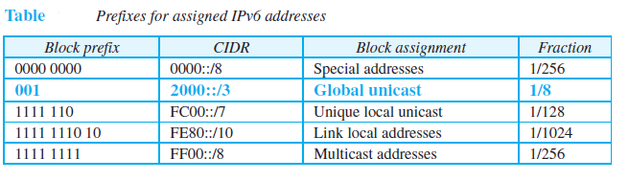
IPv6 Assignment
Like the address space of IPv4, the address space of IPv6 is divided into several blocks of varying size and each block is allocated for a special purpose.
Most of the blocks are still unassigned and have been set aside for future use. Table 22.1 shows only the assigned blocks. In this table, the last column shows the fraction each block occupies in the whole address space.

Slide 39
Data encapsulation
Delivery of data over IPv6 internetworks is accomplished by encapsulating higher-layer data into IPv6 datagrams.
IPv6 datagrams use a structure that includes a regular header and optionally, one or more extension headers. This regular header is like the header of IPv4 datagrams, though it has a different format, as we will see shortly. The standards don't give this header a name; it is just “the IPv6 header”
The IPv6 main header is required for every datagram. It contains addressing and control information that are used to manage the processing and routing of the datagram.

Slide 40
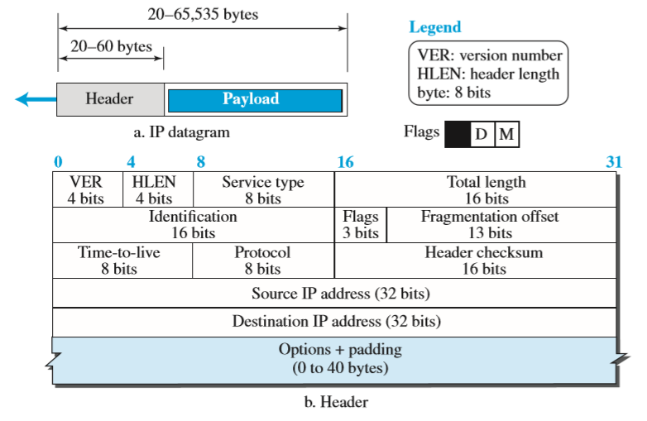
IPV4 Datagram Format
We show how IPv4 defines the format of a packet in which the data coming from the upper layer or other protocols are encapsulated. Packets used by the IP are called datagrams.

Slide 41
A datagram is a variable-length packet consisting of two parts: header and payload (data). The header is 20 to 60 bytes in length and contains information essential to routing and delivery. It is customary in TCP/IP to show the header in 4-byte sections.
Version Number: The 4-bit version number (VER) field defines the version of the IPv4 protocol, which, obviously, has the value of 4.
Header Length: The 4-bit header length (HLEN) field defines the total length of the datagram header in 4-byte words. The IPv4 datagram has a variable-length header.
Service Type: In the original design of the IP header, this field was referred to as type of service (TOS), which defined how the datagram should be handled.

Slide 42
Total Length. This 16-bit field defines the total length (header plus data) of the IP datagram in bytes. A 16-bit number can define a total length of up to 65,535 (when all bits are 1s).
Identification, Flags, and Fragmentation Offset: These three fields are related to the fragmentation of the IP datagram when the size of the datagram is larger than the underlying network can carry.
Time-to-live: Due to some malfunctioning of routing protocols (discussed later) a datagram may be circulating in the Internet, visiting some networks over and over without reaching the destination.
Protocol: In TCP/IP, the data section of a packet, called the payload, carries the whole packet from another protocol.

Slide 43
Header checksum: IP is not a reliable protocol; it does not check whether the payload carried by a datagram is corrupted during the transmission
Source and Destination Addresses: These 32-bit source and destination address fields define the IP address of the source and destination respectively.
Options: A datagram header can have up to 40 bytes of options. Options can be used for network testing and debugging.
Payload: Payload, or data, is the main reason for creating a datagram. Payload is the packet coming from other protocols that use the service of IP.

Slide 44
The IPv6 Datagram Format
The change of the IPv6 address size requires the change in the IPv4 packet format. The designer of IPv6 decided to implement remedies for other shortcomings now that a change is inevitable.
Better header format
New options. IPv6 has new options to allow for additional functionalities
Allowance for extension
Support for resource allocation
Support for more security.

Slide 45
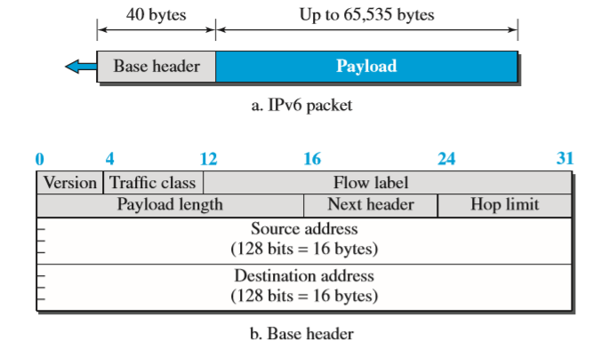
Packet Format
The IPv6 packet is shown in figure. Each packet is composed of a base header followed by the payload. The base header occupies 40 bytes, whereas payload can be up to 65,535 bytes of information. The description of fields follows.

Slide 46
❑ Version: The 4-bit version field defines the version number of the IP. For IPv6, the value is 6.
❑ Traffic class: The 8-bit traffic class field is used to distinguish different payloads with different delivery requirements. It replaces the type-of-service field in IPv4.
❑ Flow label: The flow label is a 20-bit field that is designed to provide special handling for a particular flow of data. We will discuss this field later.
❑ Payload length: The 2-byte payload length field defines the length of the IP datagram excluding the header. Note that IPv4 defines two fields related to the length: header length and total length. In IPv6, the length of the base header is fixed (40 bytes); only the length of the payload needs to be defined.

Slide 47
❑ Next header: The next header is an 8-bit field defining the type of the first extension header (if present) or the type of the data that follows the base header in the datagram. This field is similar to the protocol field in IPv4, but we talk more about it when we discuss the payload.
❑ Hop limit: The 8-bit hop limit field serves the same purpose as the TTL field in IPv4.
❑ Source and destination addresses: The source address field is a 16-byte (128-bit) Internet address that identifies the original source of the datagram. The destination address field is a 16-byte (128-bit) Internet address that identifies the destination of the datagram.

Slide 48
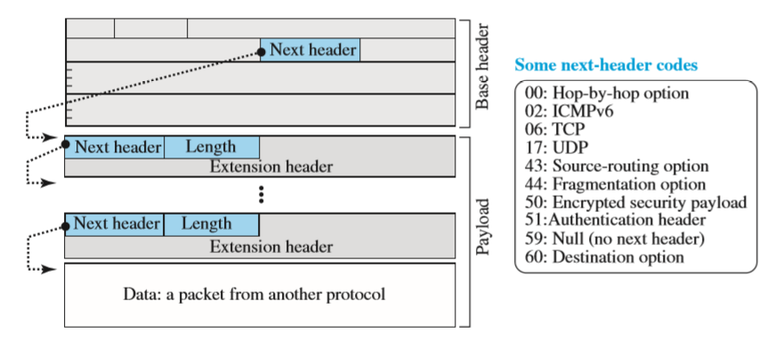
❑ Payload: Compared to IPv4, the payload field in IPv6 has a different format and meaning. The payload in IPv6 means a combination of zero or more extension headers (options) followed by the data from other protocols (UDP, TCP, and so on). In IPv6, options, which are part of the header in IPv4, are designed as extension headers.

Slide 49
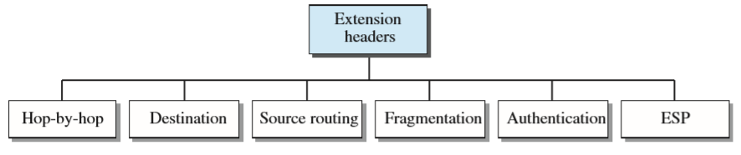
Extension Header
An IPv6 packet is made of a base header and some extension headers. The length of the base header is fixed at 40 bytes. However, to give more functionality to the IP datagram, the base header can be followed by up to six extension headers. Many of these headers are options in IPv4. Six types of extension headers have been defined. These are hop-by-hop option, source routing, fragmentation, authentication, encrypted security payload, and destination option.

Slide 50
Hop-by-Hop Option: The hop-by-hop option is used when the source needs to pass information to all routers visited by the datagram.
Destination Option: The destination option is used when the source needs to pass information to the destination only.
Source Routing: The source routing extension header combines the concepts of the strict source route and the loose source route options of IPv4.
Fragmentation: In IPv4, the source or a router is required to fragment if the size of the datagram is larger than the MTU of the network over which the datagram travels. In IPv6, only the original source can fragment.
Authentication: The authentication extension header has a dual purpose: it validates the message sender and ensures the integrity of data.
Encrypted Security Payload: The encrypted security payload (ESP) is an extension that provides confidentiality and guards against eavesdropping.

Slide 51
Comparison of Options between IPv4 and IPv6
The following shows a quick comparison between the options used in IPv4 and the options used in IPv6 (as extension headers).
❑ The no-operation and end-of-option options in IPv4 are replaced by Pad1 and PadN options in IPv6.
❑ The record route option is not implemented in IPv6 because it was not used.
❑ The timestamp option is not implemented because it was not used.
❑ The source route option is called the source route extension header in IPv6.
❑ The fragmentation fields in the base header section of IPv4 have moved to the fragmentation extension header in IPv6.
❑ The authentication extension header is new in IPv6.
❑ The encrypted security payload extension header is new in IPv6.

Slide 52
Internet Control Message Protocol (ICMP )
These are examples of situations where an error has occurred and the IP protocol has no built-in mechanism to notify the original host.
The IP protocol also lacks a mechanism for host and management queries. A host sometimes needs to determine if a router or another host is alive. And sometimes a network manager needs information from another host or router.
ICMP has been designed to compensate for the above two deficiencies. It is a companion to the IP protocol. ICMP itself is a network-layer protocol.
To enhance the reliability, Internet Control Message Protocol (ICMP) is used, which provides information about errors, loss of packets, unavailable destinations

Slide 53
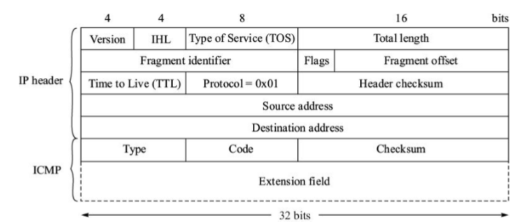
In ICMP, any destination or router that detects any problem in handling a received IP packet, generates an ICMP message addressed to the originating station of the IP packet.
ICMP messages can be analyzed by network management systems to generate network reports for the network administrators. ICMP messages are sent as IP packets.
IP packet containing ICMP.

Slide 54
ICMPv4
The Internet Control Message Protocol version 4 (ICMPv4) supports the unreliable and connectionless Internet Protocol (IP).
ICMPv4 messages are encapsulated in IP datagrams.

Slide 55
ICMPv4 MESSAGES
ICMP messages are divided into two broad categories:
error-reporting messages
query messages.
The error-reporting messages report problems that a router or a host (destination) may encounter when it processes an IP packet.
The query messages, which occur in pairs, help a host or a network manager get specific information from a router or another host.

Slide 56
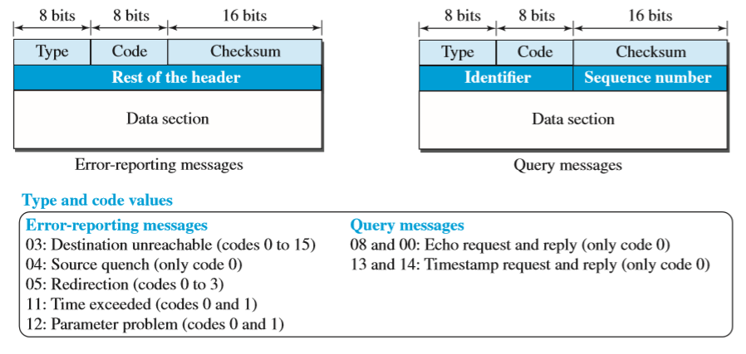
An ICMP message has an 8-byte header and a variable-size data section. Although the general format of the header is different for each message type, the first 4 bytes are common to all.
ICMP type, defines the type of the message.
The code field specifies the reason for the particular message type. T
he last common field is the checksum field (to be discussed later in the chapter).
The rest of the header is specific for each message type.

Slide 57
Error Reporting Messages
Since IP is an unreliable protocol, one of the main responsibilities of ICMP is to report some errors that may occur during the processing of the IP datagram.
ICMP does not correct errors, it simply reports them. Error correction is left to the higher-level protocols.
Error messages are always sent to the original source because the only information available in the datagram about the route is the source and destination IP addresses.
ICMP uses the source IP address to send the error message to the source (originator) of the datagram.

Slide 58
The following are important points about ICMP error messages:
No ICMP error message will be generated in response to a datagram carrying an ICMP error message.
No ICMP error message will be generated for a fragmented datagram that is not the first fragment.
No ICMP error message will be generated for a datagram having a multicast address.
No ICMP error message will be generated for a datagram having a special address such as 127.0.0.0 or 0.0.0.0.

Slide 59
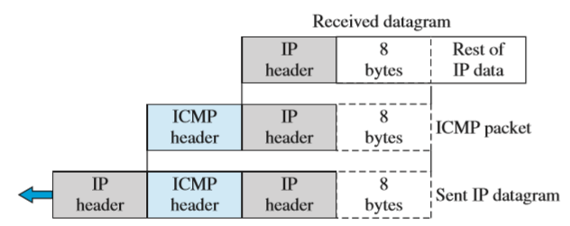
Contents of data field for the error messages

Slide 60
Types of Error messages:
Destination Unreachable
The most widely used error message is the destination unreachable (type 3). This message uses different codes (0 to 15) to define the type of error message and the reason why a datagram has not reached its final destination.
Source Quench
Another error message is called the source quench (type 4) message, which informs the sender that the network has encountered congestion and the datagram has been dropped; the source needs to slow down sending more datagrams.

Slide 61
Types of Error messages (cont…):
Redirection Message
The redirection message (type 5) is used when the source uses a wrong router to send out its message. The router redirects the message to the appropriate router, but informs the source that it needs to change its default router in the future.
Parameter Problem
A parameter problem message (type 12) can be sent when either there is a problem in the header of a datagram (code 0) or some options are missing or cannot be interpreted (code 1).

Slide 62
Query Messages
Query messages in ICMP can be used independently without relation to an IP datagram.
Query messages are used to probe or test the liveliness of hosts or routers in the Internet, find the one-way or the round-trip time for an IP datagram between two devices, or even find out whether the clocks in two devices are synchronized.
Naturally, query messages come in pairs: request and reply.
The echo request (type 8) and the echo reply (type 0) pair of messages are used by a host or a router to test the liveliness of another host or router.
A host or router sends an echo request message to another host or router; if the latter is alive, it responds with an echo reply message.

Slide 63
Debugging Tools
There are several tools that can be used in the Internet for debugging.
We can determine the viability of a host or router.
We can trace the route of a packet.
Two tools that use ICMP for debugging:
Ping
Traceroute

Slide 64
Ping
The source host sends ICMP echo-request messages; the destination, if alive, responds with ICMP echo-reply messages.
The ping program sets the identifier field in the echo-request and echo-reply message and starts the sequence number from 0; this number is incremented by 1 each time a new message is sent.
Note that ping can calculate the round-trip time. It inserts the sending time in the data section of the message.
When the packet arrives, it subtracts the arrival time from the departure time to get the round-trip time (RTT).

Slide 65
Traceroute
The traceroute program can find the IP addresses of all the routers that are visited along the path.
If there are n routers in the path, the traceroute program sends (n + 1) messages. The first n messages are discarded by the n routers, one by each router; the last message is discarded by the destination host.
The traceroute client program uses the (n + 1) ICMP error-reporting messages received to find the path between the routers.

Slide 66
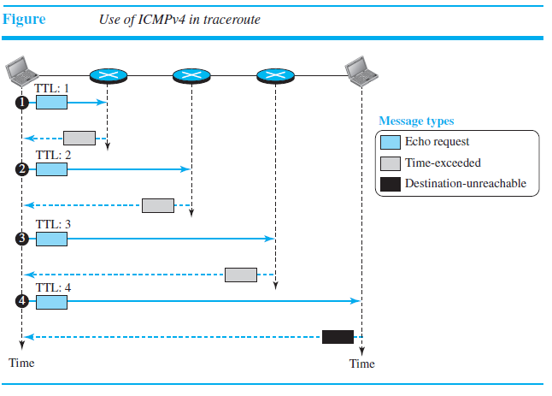

Slide 67
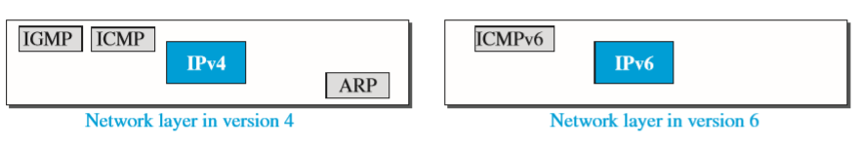
ICMPv6
This new version, Internet Control Message Protocol version 6 (ICMPv6), follows the same strategy and purposes of version 4. ICMPv6, however, is more complicated than ICMPv4.
Figure compares the network layer of version 4 to that of version 6. The ICMP, ARP and IGMP protocols in version 4 are combined into one single protocol, ICMPv6.

Slide 68
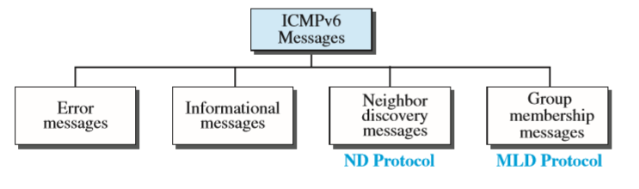
ICMPv6 messages
The messages in ICMPv6 can be divided into four groups:
Error-reporting messages
Informational messages
Neighbour-discovery messages
And group-membership messages

Slide 69
Error-Reporting Messages
One of the main responsibilities of ICMPv6 is to report errors. Four types of errors are handled:
Destination unreachable
Packet too big
Time exceeded
Parameter problems.
The redirection message has moved from the error-reporting category to the neighbor-discovery category
ICMPv6 forms an error packet, which is then encapsulated in an IPv6 datagram. This is delivered to the original source of the failed datagram.

Slide 70
Informational Messages
Two of the ICMPv6 messages can be categorized as informational messages: echo request and echo reply messages.
The echo-request and echo-reply messages are designed to check whether two devices in the Internet can communicate with each other.
A host or router can send an echo-request message to another host; the receiving computer or router can reply using the echo-reply message.
Echo-Request Message
The idea and format of the echo-request message is the same as the one in version 4.
Echo-Reply Message
The idea and format of the echo-reply message is the same as the one in version 4.

Slide 71
Neighbour-Discovery Messages
Several messages in ICMPv4 have been redefined in ICMPv6 to handle the issue of neighbor discovery.
Some new messages have also been added to provide extension: the Neighbor-Discovery (ND) protocol and the Inverse-Neighbor-Discovery (IND) protocol.
These two protocols are used by nodes (hosts or routers) on the same link (network) for three main purposes:
Hosts use the ND protocol to find routers in the neighborhood that will forward packets for them.
Nodes use the ND protocol to find the link-layer addresses of neighbors (nodes attached to the same network).
Nodes use the IND protocol to find the IPv6 addresses of neighbors.

Slide 72
Group Membership Messages
Group membership messages have two types : membership-query message and membership-report message.
Membership-Query Message
A membership-query message is sent by a router to find active group members in the network. The fields are almost the same as the ones in IGMPv3 except that the size of the multicast address and the source address has been changed from 32 bits to 128 bits.
Membership-Report Message
The format of the membership report in MLDv2 is exactly the same as the one in IGMPv3 except that the sizes of the fields are changed because of the address size. In particular, the record type is the same as the one defined for IGMPv3 (types 1 to 6).

Slide 73
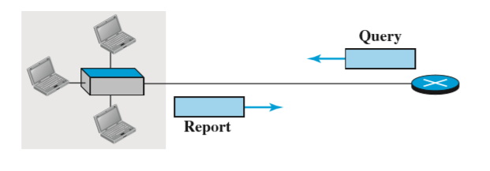
Internet Group Management Protocol (IGMP )
The protocol that is used today for collecting information about group membership is the Internet Group Management Protocol (IGMP).
IGMP is a protocol defined at the network layer; it is one of the auxiliary protocols, like ICMP, which is considered part of the IP.
IGMP messages, like ICMP messages, are encapsulated in an IP datagram.
IGMP operation

Slide 74
IGMP Messages
There are only two types of messages in IGMP version 3,
Query Messages
Report Messages
A query message is periodically sent by a router to all hosts attached to it to ask them to report their interests about membership in groups.
A report message is sent by a host as a response to a query message.

Slide 75
Query Message
The query message is sent by a router to all hosts in each interface to collect information about their membership. There are three versions of query messages, as described below:
A general query message is sent about membership in any group. It is encapsulated in a datagram with the destination address 224.0.0.1 (all hosts and routers).
A group-specific query message is sent from a router to ask about the membership related to a specific group.
A source-and-group-specific query message is sent from a router to ask about the membership related to a specific group when the message comes from a specific source or sources.

Slide 76
Report Message
A report message is sent by a host as a response to a query message.
The message contains a list of records in which each record gives the identifier of the corresponding group (multicast address) and the addresses of all sources that the host is interested in receiving messages from (inclusion).
The record can also mention the source addresses from which the host does not desire to receive a group message (exclusion).

Slide 77
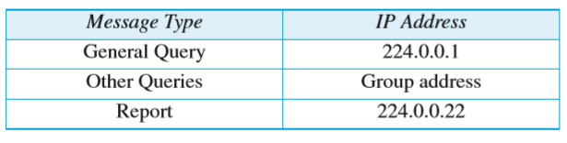
Propagation of Membership Information
After a router has collected membership information from the hosts and other routers at its own level in the tree, it can propagate it to the router located in a higher level of the tree.
Encapsulation
The IGMP message is encapsulated in an IP datagram with the value of the protocol field set to 2 and the TTL field set to 1. The destination IP address of the datagram, however, depends on the type of message

Slide 78
Introduction to Routing and Switching concepts

Slide 79
Router
A router is a physical or virtual appliance that passes information between two or more packet-switched computer networks.
A router inspects a given data packet's destination Internet Protocol address (IP address), calculates the best way for it to reach its destination and then forwards it accordingly.
A router is a common type of gateway. It is positioned where two or more networks meet at each point of presence on the internet.

Slide 80
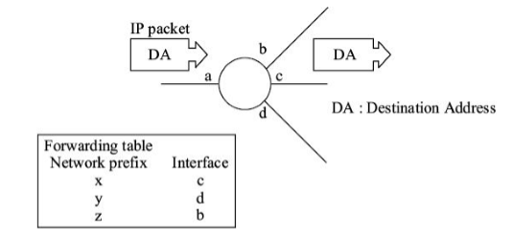
Working of a router
An IP datagram is routed hop-by-hop across a network to the destination using forwarding tables that are stored in the routers in advance.
A forwarding table in a router contains <destination network prefix, next hop> associations .
When an IP packet is received by a router, its Destination Address (DA) is matched with one of the entries in the forwarding table and the IP packet is forwarded through the interface indicated in the forwarding table.
Forwarding table.

Slide 81
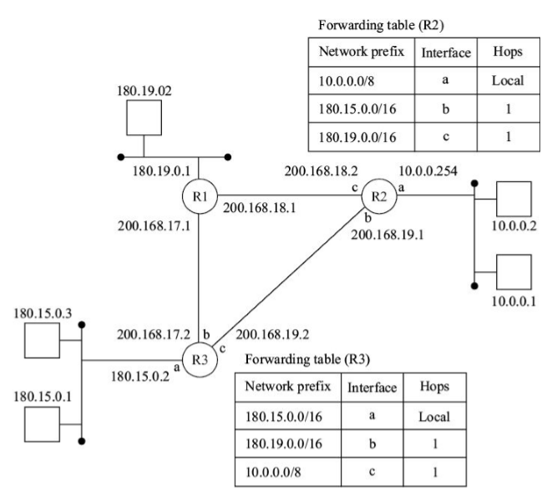
Procedure of packets getting scan in router to enter a network (Complete Picture of IP Packet Delivery)

Slide 82
We assume that routers R1, R2, and R3 are interconnected using a data link protocol (e.g. HDLC) which is already in data transfer mode. The local area network connecting the hosts and routers is ethernet. The process is as follows:
Host 180.15.0.1 sends ARP-request packet using the target IP address (180.15.0.2) of its default gateway router R3. The packet is encapsulated in ethernet frame with destination MAC address as broadcast address.
R3 replies with ARP-response indicating its MAC address. ARP-response is encapsulated in ethernet frame with MAC addresses of R3 and the host.
Host (180.15.0.1) sends the IP packet addressed to the host 10.0.0.1. The IP packet is encapsulated in the ethernet frame with the MAC address of R3.
R3 receives the IP packet, consults its forwarding table, which indicates that the packet should be forwarded through its interface c. It encapsulates the packet in the data link frame (e.g. HDLC) and sends the frame to R2.

Slide 83
R2 receives the frame and the encapsulated IP packet. It consults its forwarding table and determines that the destination IP address is on the local network. It sends an ARP-request packet with target IP address 10.0.0.1 to find the MAC address of the destination host. The ARP-request is sent using ethernet encapsulation and broadcast MAC address.
Host 10.0.0.1 sends its ARP-response to R2 containing its MAC address. It uses ethernet encapsulation with MAC address of R2.
R2 sends the IP packet received from host 180.15.0.1 to the host 10.0.0.1. The packet is sent in an ethernet frame with MAC address of the destination host.
The subsequent IP packets from the host 180.15.0.1 to the host 10.0.0.1 do not invoke ARP since the ARP cache contains the required MAC addresses.

Slide 84
Advantages of Router:
a) Router can function on LAN & WAN.
b) Router can connect different media & architectures.
c) Router can determine best path/route for data to reach the destination.
Disadvantages of Router:
a) Router only works with routable protocol.
b) Routing updates consume bandwidth.
c) Increase latency due to greater degree of packet filtering.

Slide 85
Transport Layer

Slide 86
Transport Layer:
The transport layer in the TCP/IP suite is located between the application layer and the network layer.
It provides services to the application layer and receives services from the network layer.
The transport layer acts as a liaison between a client program and a server program, a process-to-process connection.

Slide 87
Transmission Control Protocol(TCP),
TCP is a connection oriented layer-4 protocol and it provides reliable service between computer processes (applications) that reside in two different end systems.
It uses services of underlying IP layer which provides connectionless and unreliable service.
TCP, therefore, has inbuilt mechanisms for error control, flow control, and sequenced delivery of the user data octets.

Slide 88
The basic operational features :
It has three phases of operation connection—establishment, data transfer, and disconnection phase.
A data unit at TCP layer is called TCP segment, which is equivalent to a frame at layer 2 and packet at layer 3. A TCP segment contains a header and user data octets.
Continuous repeat request with sliding window flow control is used.
The window contains user data octets, not full TCP segments. Thus flow control is based on volume of user data octets, not on number of TCP segments that can be transmitted.

Slide 89
Window size is dynamic and is controlled by the receiver at the other end.
All user data octets are acknowledged but acknowledgements may not be individual. It has inbuilt timeout mechanism for retransmission of unacknowledged TCP segments. Acknowledgements are piggybacked on a TCP data segment.
Mode of communication is two-way simultaneous.

Slide 90
User Datagram Protocol (UDP)
UDP is a connectionless transport protocol that operates on IP layer. It is specified in RFC 768.
Its main features are:
UDP provides connectionless service to the application layer. Being connectionless, its service is unreliable.
Each UDP datagram is transported from source to the destination independent of others. The delivery of user data may not be sequenced.
There is no flow control or acknowledgement mechanism.
There is optional checksum field in UDP datagram. It provides end-to-end error detection capability in the user data.
It is less complex than TCP and easy to implement.

Slide 91
When it is used ?
UDP is used where the overhead of a connection-oriented service is undesirable. Examples of such applications are given below:
Periodic collection of data from sensors, transmission of alarms from security devices.
Outward transmission of short broadcast messages.
UDP is also used where retransmission of lost segments makes no sense. For example, UDP is used for transmission of digital voice over IP. Retransmission of a lost voice packet does not make sense.

Slide 92
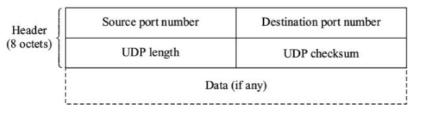
Format of UDP Datagram
Source port number (2 octets): Port number of the source process.
Destination port number (2 octets): Port number of the destination process.
UDP length (2 octets): This field indicates length of UDP datagram (header plus data) in octets.
UDP checksum (2 octets): This field contains 1’s complement of the sum of all the 1’s complements of 16-bit words in the UDP segment including user data field and pseudo IP header. If the computed value UDP checksum comes to all zeroes, all checksum bits are set to 1. UDP checksum is optional. If it is not used, it is set to all zeroes.

Slide 93
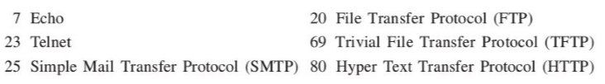
Overview of Ports
TCP provides service to the higher layer through a port.
A port is similar to Service Access Point (SAP) in OSI. Each communicating computer process is assigned a port number.
By using different port numbers, a TCP layer can simultaneously serve multiple processes, e.g. e-mail, FTP, etc. as shown in Figure 20.3.
Port number range 0–1023 is reserved for common applications.
These are assigned by IANA (Internet Assigned Numbers Authority). Some well-known ports are listed below:

Slide 94
Sockets
A socket is one endpoint of a two-way communication link between two programs running on the network. A socket is bound to a port number so that the TCP layer can identify the application that data is destined to be sent to.
The combination of IP address and port is called a socket.
Each socket pair uniquely identifies a connection.
The connection between processes P1 and P4 in end systems A and B respectively can be written as <socket (33, 10.0.0.1), socket (67, 10.0.0.3)>.

Slide 95
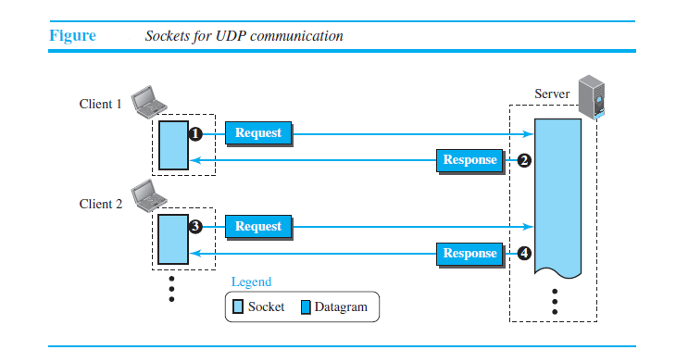

Slide 96
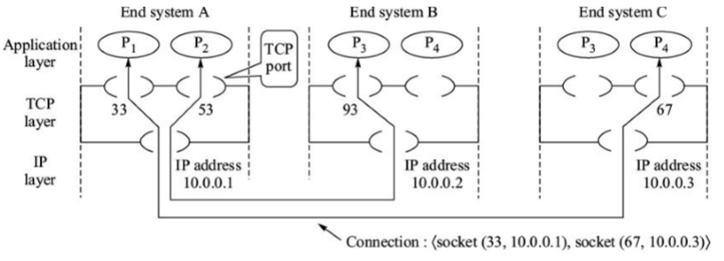
TCP ports and connections.

Slide 97
Application Layer

Slide 98
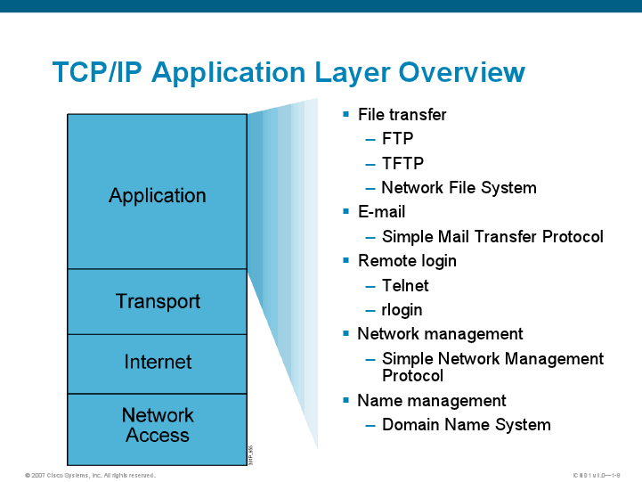
Application Layer:
The application layer provides services to the user.
Communication is provided using a logical connection, which means that the two application layers assume that there is an imaginary direct connection through which they can send and receive messages.

Slide 99
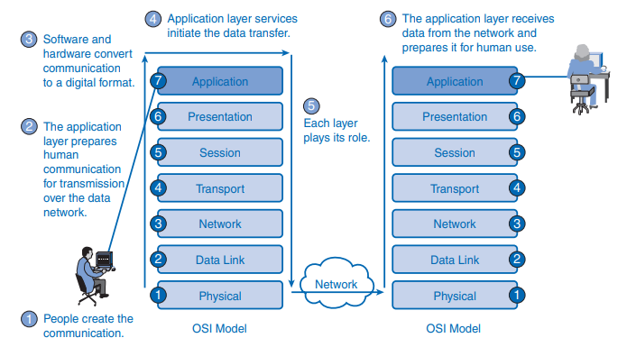
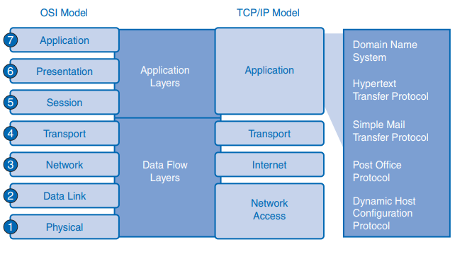
OSI Encapsulation Process
OSI and TCP/IP Model

Slide 100
Dynamic Host Configuration Protocol (DHCP)
The Dynamic Host Configuration Protocol (DHCP) is a network management protocol used on Internet Protocol networks whereby a DHCP server dynamically assigns an IP address and other network configuration parameters to each device on a network so they can communicate with other IP networks.
A DHCP server has an address pool and when a request comes, it allocates an address from the pool.
DHCP is based on client-server mode of operation and uses the same UDP ports as Bootstrapping Protocol (BOOTP).

Slide 101
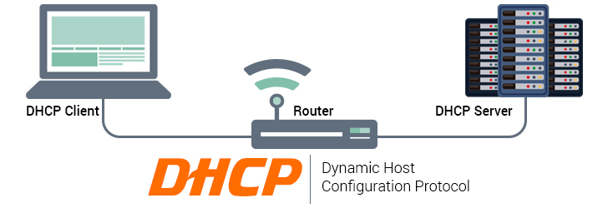
Configurable Parameters
DHCP has three modes of assignment of IP addresses:
1. Automatic: DHCP assigns the address on permanent basis.
2. Dynamic: The address is assigned (leased) for a limited period.
3. Manual: The address assignment is manually configured.

Slide 102
Message Types
The following types of messages are sent by the client and by the server. These messages are contained in the options area and are identified by option code 53 and type field which contains the type value.
DHCPDISCOVER (Type 1): Broadcast from client to find DHCP server(s).
DHCPOFFER (Type 2): Response from the server to DHCPDISCOVER offering IP and other parameters.
DHCPREQUEST (Type 3): Message from the client to indicate selection of the parameters offered by a server. It is also indication to other servers declining their offers. The client also requests extension of lease time using this message.
DHCPDECLINE (Type 4): Message from the client to the server indicating an error.
DHCPACK (Type 5): Acknowledgement from the server to the client.
DHCPNACK (Type 6): Negative acknowledgement from the server to client if the IP address requested by the client is invalid or the lease is expired.
DHCPRELEASE (Type 7): Message from the client to the server canceling remainder of the lease and releasing the IP address.
DHCPINFORM (Type 8): Message from the client that it already has a configured IP address but needs additional configuration parameters.

Slide 103
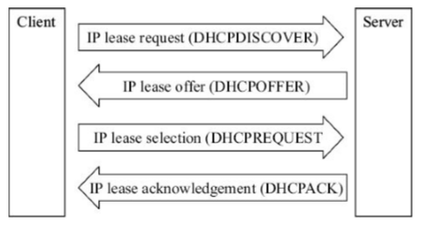
a typical exchange of DHCP messages between a client and a server for IP address lease

Slide 104
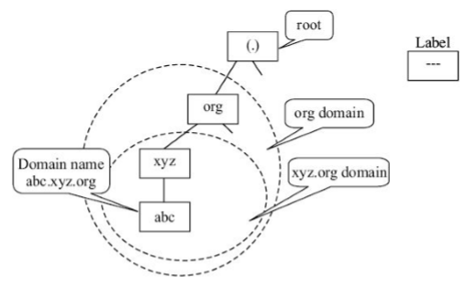
Domain Name System(DNS)
The Internet uses a hierarchical naming system called Domain Name System (DNS). Its tree like structure is similar to the example given above.
It maps the IP address of the hosts to a human readable format. It is implemented as distributed database worldwide on DNS ‘name servers’.
Domain: It is a complete sub-tree under a particular point in the naming tree structure (Figure 22.3). Note the emphasis on naming tree structure. A domain has nothing to do with geographic distribution of hosts.

Slide 105
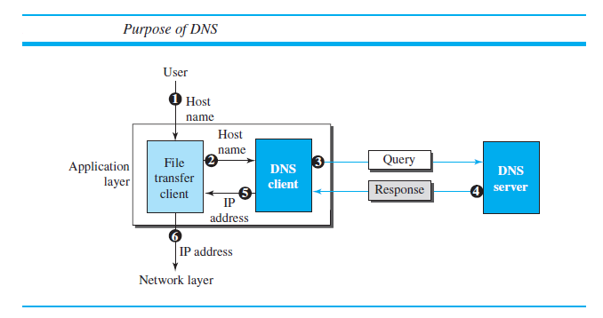

Slide 106
Label: It is a component of a domain name and identifies a local entity at a particular hierarchy level. For example, SW is the label assigned to the software engineering division of the computer science department.
Domain name: It is the name given to a node in the naming tree. It consists of all the labels from the root to the node, listed from right to left and separated by dots (.). It has the following characteristics:
A domain name may consist of maximum 255 characters.
Domain names are not case sensitive. For example, www.nic.org is same as WWW. NIC.ORG.
Due to SMTP restrictions, domain names can contain only the characters a to z (lower or upper case), numerals 1 to 9 and symbol (-).
A Fully Qualified Domain Name (FQDN) is concatenation of all the labels up to the root of the naming tree.
Hosts with multiple IP addresses can be assigned a single domain name.
Hosts with single IP address can have multiple domain names depending on applications, e.g. the domain names can be www. abc, mail. abc, etc. to differentiate several services.

Slide 107
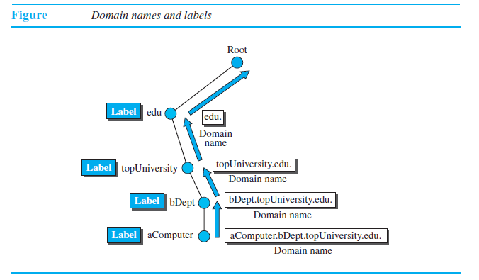

Slide 108
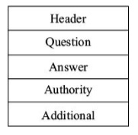
DNS Protocol
DNS is based on the client-server model. DNS messages are of two types— queries (and replies) and zone transfers. Queries use UDP transport protocol and zone transfers use TCP transport protocol. DNS queries are limited to 512 bytes. The well-known port for the DNS server is 53
Structure of DNS message
Header: It contains identifiers that associate queries with responses.
Question: It contains the queries for the DNS server.
Answer. It contains the Resource Records (RR) that answer the queries.
Authority: It contains the list of authorities that serve a particular domain.
Additional: This section contains additional information that does not form part of the sections above.

Slide 109
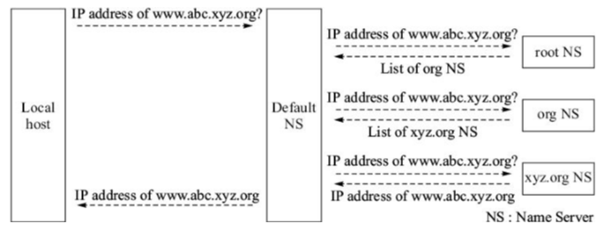
a typical exchange of DNS messages to find IP address of the name www.abc.xyz.org.

Slide 110
Hypertext Transfer Protocol HTTP/HTTPS
Hypertext Transfer Protocol (HTTP) is an application-layer protocol for transmitting hypermedia documents, such as HTML.
It was designed for communication between web browsers and web servers, but it can also be used for other purposes.
HTTP follows a classical client-server model, with a client opening a connection to make a request, then waiting until it receives a response.

Slide 111
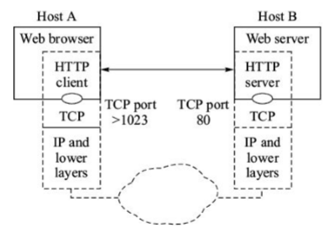
HTTP runs on the well-known TCP port 80 for the server The basic operation consists of three steps:
1. The client opens a TCP connection and sends request for a document.
2. The server responds with the document.
3. The server closes the connection.

Slide 112
HTTP messages from the client to the server are called HTTP request messages. HTTP messages from the server to the client are called response messages. These messages consist of a header and a body as described below. The body contains data described by a MIME header. The data can be HTML document (Web page), graphic, video or sound.
There are several types HTTP-Methods. The important ones are described below:
GET: GET is a request that allows the client to retrieve the information as identified in the URL.
HEAD: This request is same as GET except that the server’s response consists only of the header as if body were present.
POST: POST request consists of a header and a body
PUT: It is a request to store the attached entity in the body of the request under the supplied URL. It can be a new URL or an existing URL.
DELETE: DELETE requests the server to delete the resource identified by the URL.
TRACE: TRACE allows the client to see how the message was received and retrieved at the other end.
COPY: It is a request to copy the resource identified by the URL in the request line to the locations indicated in the URL-Header field that follows the request line of the message.
MOVE: It requests the server to move the resource identified by the URL in the request line to the locations given in the URL-Header field.

Slide 113
File Transfer Protocol (FTP)
File Transfer Protocol (FTP) is the standard protocol provided by TCP/IP for copying a file from one host to another.
Although transferring files from one system to another seems simple and straightforward, some problems must be dealt with first.
For example, two systems may use different file name conventions. Two systems may have different ways to represent data. All of these problems have been solved by FTP in a very simple and elegant approach.

Slide 114
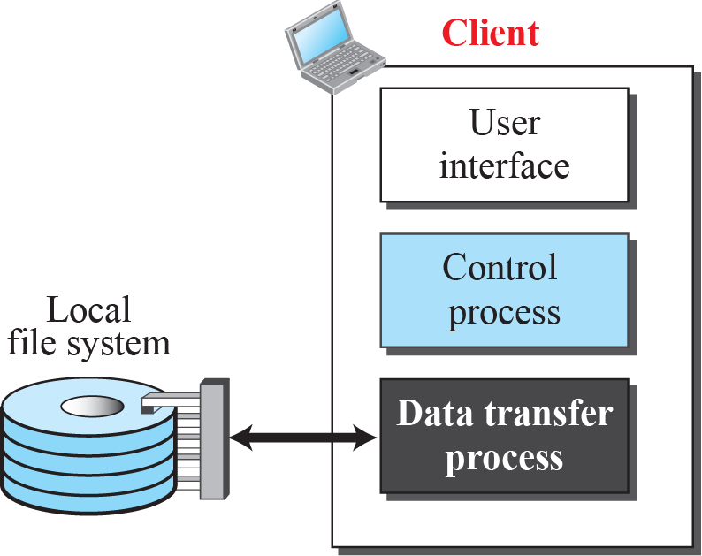
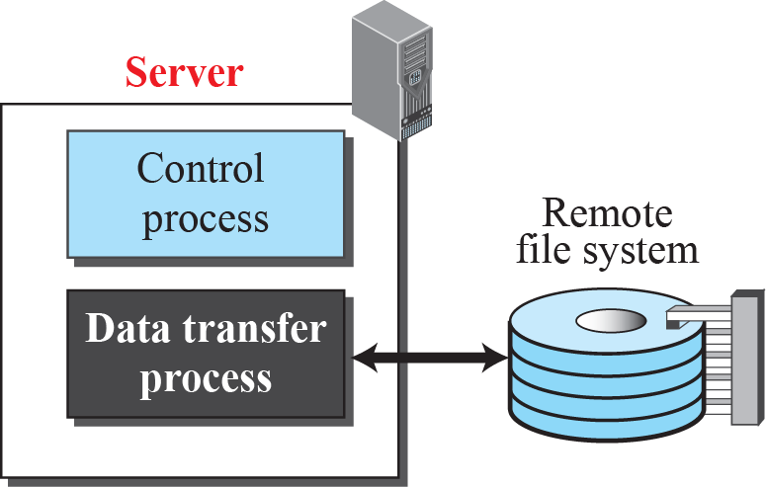
FTP
2.114

Slide 115
The basic features of FTP are:
Data representation: FTP handles three types of data representations— ASCII (7 bit), EBCDIC (8-bit), and 8-bit binary data.
File organization: FTP supports unstructured and structured files.
Transmission mode: In stream mode, the file is transmitted as continuous bit stream without any modification. EOF and EOR, where applicable, are inserted as the two byte sequence.
Error control: Since TCP is used for data transfer no additional error recovery mechanism is required.
Access control: File access protection is done using login procedure with login name and password.

Slide 116
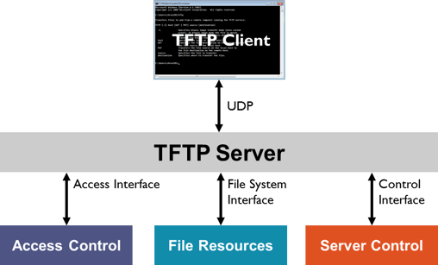
Trivial File Transfer Protocol (TFTP)
Trivial File Transfer Protocol (TFTP) is a simple lockstep File Transfer Protocol which allows a client to get a file from or put a file onto a remote host.
TFTP is suited for applications that do not require rather complex procedures of FTP (File Transfer Protocol) and do not have enough resources (RAM, ROM) for this purpose.
For example, FTP requires multiple concurrent session which may not be possible on small diskless machines or network devices such as bridges, routers, etc.

Slide 117
The main features of TFTP are:
TFTP is based on client-server principle and uses well-known UDP port number 69 for the TFTP server.
TFTP is unsecured protocol and does not support authentication.
TFTP incorporates idle-RQ (stop and wait) error recovery mechanism.
– Every TFTP data unit bears a sequence number.
– Each data unit is individually acknowledged. After receiving the acknowledgement the next data unit is sent.
– Error recovery is by retransmission after timeout. TFTP uses adaptive timeout with exponential back-off algorithm.

Slide 118
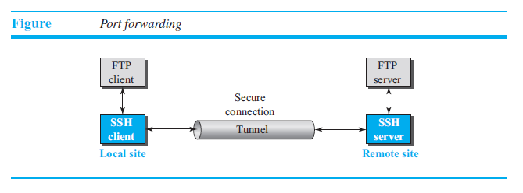
Secure File Transfer Protocol (SFTP)
Secure File Transfer Protocol (also SSH File Transfer Protocol, or SFTP) is a network protocol that provides file access, file transfer, and file management over any reliable data stream.
SFTP uses SSH to transfer files and requires that the client be authenticated by the server.
Commands and data are encrypted in order to prevent passwords and other sensitive information from being exposed to the network in plain text.
The sftp application program uses one of the channels provided by the SSH to transfer files.

Slide 119
Advantages of using SFTP
Data Exchange
– SFTP formats commands and data into special packets and sends them through a single connection. It does not use separate channels like FTP does. This eliminates the inconvenience to server administrators who otherwise need to open up a range of ports for conventional FTP connections.
Security
– With FTP, both channels are generally sent unencrypted and this data can be intercepted and read by other parties. Some FTP servers enforce security by connecting via Implicit SSL and Explicit SSL connections.
Firewall
– SFTP uses Port 22 for server inbound connections and client outbound connections. This makes SFTP firewall friendly as it only needs a single port to be opened through the firewall.
Meta-data
– With SFTP, users are able to access meta-data like date, time, size, permissions and other information accurately while some FTP servers, especially older ones, may have trouble getting this information correctly, while others do not provide them at all.

Slide 120
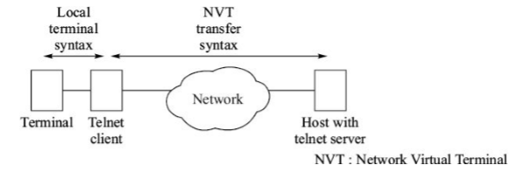
Telnet
Telnet is an application protocol used on the Internet or local area network to provide a bidirectional interactive text-oriented communication facility using a virtual terminal connection.
User data is interspersed in-band with Telnet control information in an 8-bit byte oriented data connection over the Transmission Control Protocol (TCP).
One of the original remote logging protocols is TELNET, which is an abbreviation for TErminaL NETwork. Although TELNET requires a logging name and password, it is vulnerable to hacking because it sends all data including the password in plaintext (not encrypted).
Telnet client and server

Slide 121
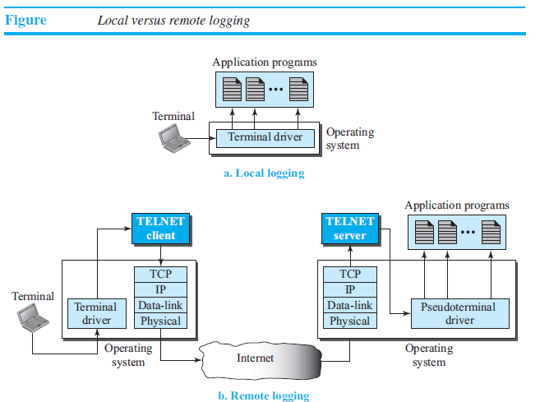

Slide 122
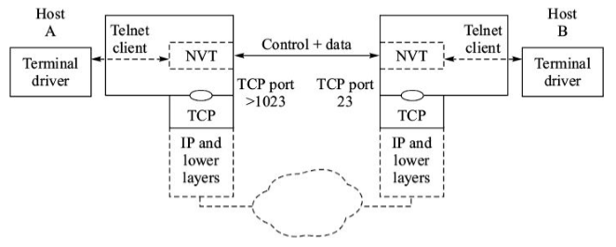
Telnet is a connection-oriented protocol and uses TCP at the transport layer. The telnet server is connected to the well-known TCP port 23. The telnet client can be on any TCP port > 1023.
A telnet client can emulate the behaviour of a wide range of well-known terminals. Internally the telnet client communicates with the telnet server through a canonical terminal representation called Network Virtual Terminal (NVT) as shown in Figure.
Thus, the local terminal device characteristics are mapped to NVT capabilities. The user’s keystrokes received by the local terminal driver are sent to the telnet client which transforms these to a universal character set of the NVT. The process is reversed at the other end.

Slide 123
Email
The electronic mail system needs two UA (User Agents) s, two pairs of MTA (message transfer agent)s (client and server), and a pair of MAA (message access agent)s (client and server).
Mail Format
Mail format is defined by RFC 822 with extension MIME. It consists of two parts—an envelope or header and a body. Both parts are represented in ASCII. The body is assumed to be simple text, although it may be encoded image or voice/video clip or data.
Header: The header contains information necessary for transmission and delivery of the mail. It also includes the sender’s identification.
Body: The body of the mail is separated from the header by a blank line. It contains user’s message. RFC 822 restricts the maximum size of the body to 1000 characters. But MIME extends it further in certain cases. The body always contains character codes from ASCII. The

Slide 124
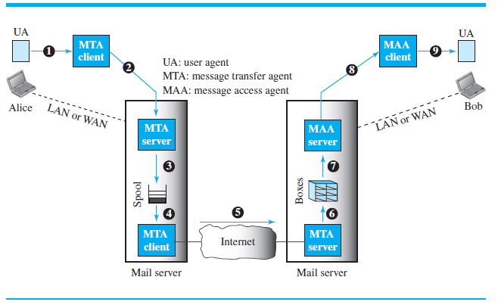

Slide 125

Message Transfer Agent: Simple Mail Transfer Protocol (SMTP)
The formal protocol that defines the MTA client and server in the Internet is called
Simple Mail Transfer Protocol (SMTP).
SMTP is based on client-server model and it uses well-known TCP port number 25 for the server All the commands, responses, and messages are in ASCII format (printable characters with binary values from 33 to 126, CR and LF).

Slide 126


Slide 127
Message Access Agent: POP and IMAP
The first and second stages of mail delivery use SMTP. However, SMTP is not involved in the third stage because SMTP is a push protocol; it pushes the message from the client to the server.
In other words, the direction of the bulk data (messages) is from the client to the server. On the other hand, the third stage needs a pull protocol; the client must pull messages from the server
Post Office Protocol, version 3 (POP3) is simple but limited in functionality. The client POP3 software is installed on the recipient computer; the server POP3 software is installed on the mail server.
Another mail access protocol is Internet Mail Access Protocol, version 4 (IMAP4). IMAP4 is similar to POP3, but it has more features; IMAP4 is more powerful and more complex

Slide 128

NTP
The Network Time Protocol (NTP) is a networking protocol for clock synchronization between computer systems over packet-switched, variable-latency data networks.
The goal of NTP is to ensure that all computers on a network agree on the time, since even a small difference can create problems. For example, if there is more than 5 minutes difference on your host and the Active Directory domain controller, we will not be able to login into our AD domain.

Slide 129
How does NTP work?
The NTP client initiates a time-request exchange with the NTP server.
As a result of this exchange, the client is able to calculate the link delay and its local offset, and adjust its local clock to match the clock at the server's computer.
As a rule, six exchanges over a period of about five to 10 minutes are required to initially set the clock.
Once synchronized, the client updates the clock about once every 10 minutes, usually requiring only a single message exchange.
In addition to client-server synchronization. This transaction occurs via the User Datagram Protocol on port 123. NTP also supports broadcast synchronization of peer computer clocks.

Slide 130
Thank you!!!
Questions??

